Slide 1
Introduction to Reinforcement Learning A mini course @ HCMUS, Vietnam Lectures 4-6
Long Tran-Thanh
Long.tran-thanh@warwick.ac.uk

Slide 2
Function approximation

Slide 3
From tabular to large-scale RL
So far:
We have access to/can observe every single V(s) and Q(s,a)
This is called tabular RL (we can store these values in, e.g., lookup tables)
Large-scale RL:
State/action space is very large
Backgammon: 10^20 states
Computer Go: 10^170 states
Helicopter flying: continuous state space
Issues of naïve application of tabular RL to large-scale RL:
Lack of memory storage
Cannot visit every state (or state-action pair)

Slide 4
Function approximation in RL
Idea:
Think about V(s) and Q(s,a) as functions on s and (s,a), respectively
Use some function approximation techniques to approximate these functions
Advantages:
Can approximate unseen states/state-action pairs
Concise representations
Disadvantages:
Decreased accuracy
Need to learn the best representation (extra layer of complexity)

Slide 5
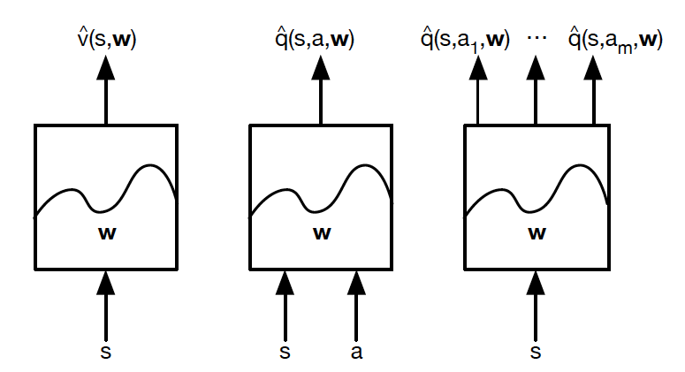
Function approximation in RL
Taken from David Silver’s slides

Slide 6
Function approximation in RL
Types of function approximators:
Linear combination of features
Neural network
Decision tree
Nearest neighbour
Fourier / wavelet bases
...

Slide 7
Function approximation in RL
Types of function approximators:
Linear combinations of features
Neural network
Decision tree
Nearest neighbour
Fourier / wavelet bases
...

Slide 8
Function approximation in RL
Types of function approximators:
Linear combinations of features
Neural network
Decision tree
Nearest neighbour
Fourier / wavelet bases
...
These are differentiable function approximators

Slide 9
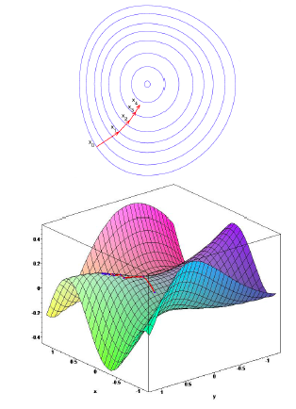
A bit of continuous optimisation (gradient descent)
J(w): a differentiable function of parameter vector w
Goal: find local (global) minimum of J(w)
Gradient of J(w):
Adjust w in the direction of the negative gradient
Taken from David Silver’s slides

Slide 10
Value function approximation with SGD
Problem def: Given policy and true value function
Goal: Find parameter vector w that minimises the following
Mean-Squared Error (loss) function:
Taken from David Silver’s slides

Slide 11
Value function approximation with SGD
Problem def: Given policy and true value function
Goal: Find parameter vector w that minimises the following
Mean-Squared Error (loss) function:
Gradient descent algorithm:
Issue: we cannot have value of all s -> we sample some
Taken from David Silver’s slides

Slide 12
Value function approximation with SGD
Problem def: Given policy and true value function
Goal: Find parameter vector w that minimises the following
Mean-Squared Error (loss) function:
Gradient descent algorithm:
Issue: we cannot have value of all s -> we sample some s
Stochastic gradient descent (SGD):
Taken from David Silver’s slides

Slide 13
Linear state value function approximation
Feature vector of each state s:
Linear function approximator:

Slide 14
Linear state value function approximation
Feature vector of each state s:
Linear function approximator:
Loss function:
Quadratic in w
Stochastic gradient descent will converge to the global minimum
SGD’s update rule becomes very simple:
step size
prediction error
feature vector

Slide 15
Linear state value function approximation
In an ideal world:
Loss function:
SGD’s update rule :

Slide 16
Linear state value function approximation
In an ideal world:
Loss function:
SGD’s update rule:
In real life, we don’t know
Idea: use model-free approaches (MC, TD) to evaluate

Slide 17
Linear state value function approximation
In an ideal world:
Loss function:
SGD’s update rule:
In real life, we don’t know
Idea: use model-free approaches (MC, TD) to evaluate
Implementation: in the formulae above, replace with:
Total return in case of MC
TD target in case of TD(0) or TD(lambda)

Slide 18
Linear state value function approximation
MC method:
TD(0) learning:
TD(lambda):
Forward-view:
Backward-view:

Slide 19
State-action value function approximation
So far we focused on approximating the value function of a given policy
Now let’s investigate how to find the optimal policy under the function approximation framework

Slide 20
State-action value function approximation
So far we focused on approximating the value function of a given policy
Now let’s investigate how to find the optimal policy under the function approximation framework
Recall that if we want to learn the optimal policy, we need to evaluate the value function of state-action pairs -> we need to approximate this function

Slide 21
State-action value function approximation
So far we focused on approximating the value function of a given policy
Now let’s investigate how to find the optimal policy under the function approximation framework
Recall that if we want to learn the optimal policy, we need to evaluate the value function of state-action pairs -> we need to approximate this function
How to do it?
Use SGD to optimise w to minimse the MSE loss function
Combine this with model-free approaches

Slide 22
Linear state-action value function approximation
We go straight to the linear function approximation case:
Linear state-action value function:
Stochastic gradient descent update (if we know the true q value):

Slide 23
Linear state-action value function approximation
In case we don’t know the true Q values:
Use the model-free approaches to estimate these Q values

Slide 24
Linear state-action value function approximation
In case we don’t know the true Q values:
Use the model-free approaches to estimate these Q values
MC-based:

Slide 25
Linear state-action value function approximation
In case we don’t know the true Q values:
Use the model-free approaches to estimate these Q values
MC-based:
TD-based (SARSA, Q-learning):
TD(0):

Slide 26
Linear state-action value function approximation
In case we don’t know the true Q values:
Use the model-free approaches to estimate these Q values
MC-based:
TD-based (SARSA, Q-learning):
TD(0):
Forward-view TD(lambda):
Backward-view TD(lambda):

Slide 27
Non-linear value function approximation
Linear function approximation:
Simple model space
Nice theoretical properties
Efficient provably converging solutions (SGD)

Slide 28
Non-linear value function approximation
Linear function approximation:
Simple model space
Nice theoretical properties
Efficient provably converging solutions (SGD)
But:
Model misspecification (most applications are non-linear)
Can we do better with non-linear function approximation? How?

Slide 29
Non-linear value function approximation
Linear function approximation:
Simple model space
Nice theoretical properties
Efficient provably converging solutions (SGD)
But:
Model misspecification (most applications are non-linear)
Can we do better with non-linear function approximation? How?
Idea: use deep neural nets to approximate the value functions

Slide 30
Deep Neural Nets

Slide 31
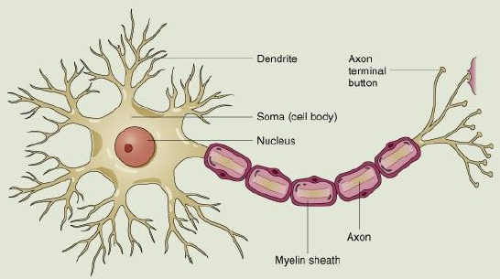
Biological Neurons

Slide 32
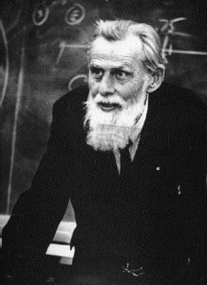
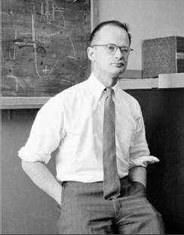
Inspiration from the brain
Warren McCulloch and Walter Pitts (1943) "A Logical Calculus of the Ideas Immanent in Nervous Activity".
X1
Neuron
X2
Y: Output
X3
Contains key properties of real neurons:
Synaptic weights
Cumulative affect
Threshold for activation "all or nothing”
(neuron fires an output signal if the sum of inputs is above threshold)

Slide 33
w1
The perceptron model (Rosenblatt, 1957)
X1
neuron
w2
X2
Y: Output
X3
w3
Synaptic weights
Cumulative affect
Threshold for activation "all or nothing”
Self-training the weights

Slide 34
w1
Perceptron as linear separator/regressor
X1
neuron
w2
X2
Y: Output
X3
w3
f: activation function

Slide 35
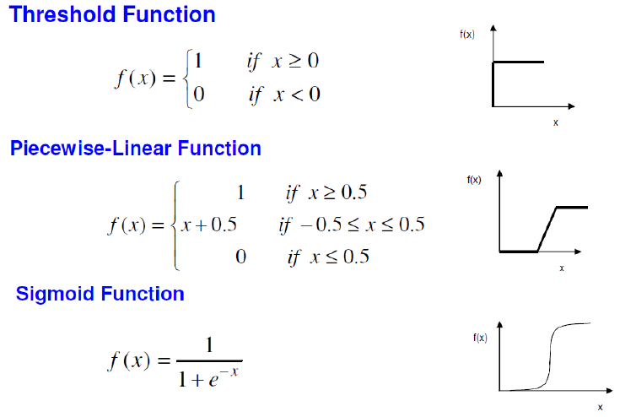
Types of activation functions

Slide 36
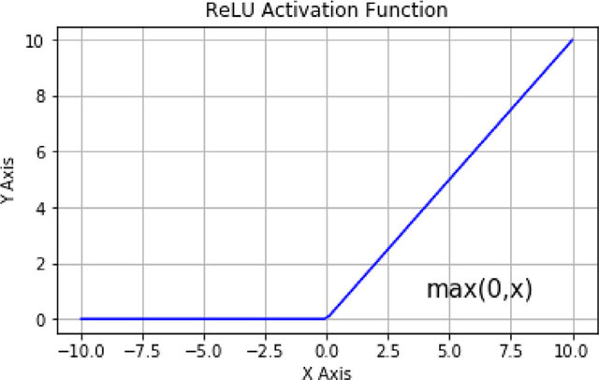
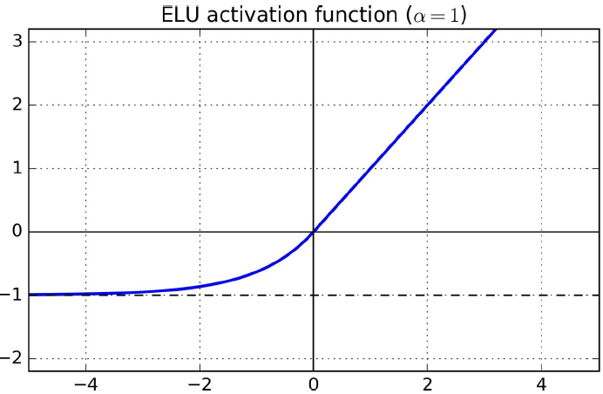
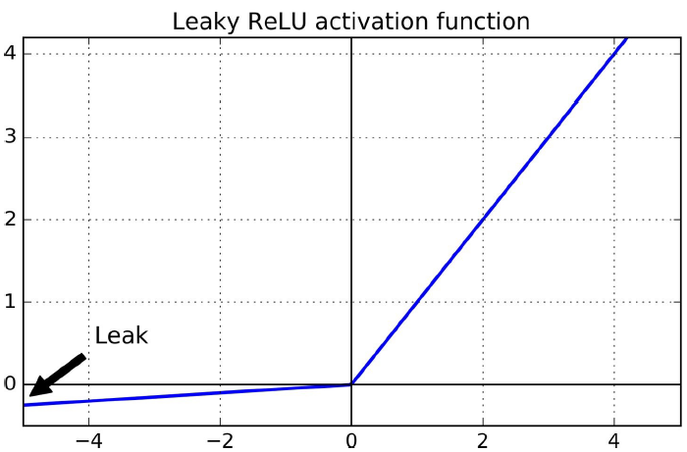
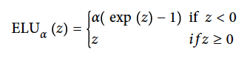
Types of activation functions
ReLU (rectified linear unit)
ELU (exponential linear unit)
Leaky ReLU

Slide 37
Multi-layered neural networks
How can we achieve non-linear separators with the perceptron model?
Possible solution: multi-layer neural nets
Instead of having inputs feeding directly into output neurons, let’s add some intervening "hidden" neurons in between? The brain is certainly like that.
Intuition: If we think of single neuron as dividing a space into low vs high output with a single line...
… then multiple neurons = multiple dividing lines
Non-linear separation can be approximated by a set of linear lines

Slide 38
Multi-layered neural networks (cont’d)
X1
f
f
X2
Y
f
1
Input layer
Hidden layers
Output layer
Neurons feeding into other neurons...
Our black box is quite complicated now; can approximate arbitrary functions given enough hidden neurons.

Slide 39
Training multi-layered neural networks
This sounds cool! But bow can we train this complex back box?
Idea: We could use the usual gradient descent approach to train the weights between the last hidden layer and the output layer.
Input layer
Hidden layer 1
Hidden layer N
Output layer
Issue: what about the weights of the other hidden layers?
Solution: backpropagation of errors (Rumelhart, Hinton, and Williams, 1986)

Slide 40
Deep neural networks
Main idea of deep neural networks: transform the input space into higher level abstractions with lower dimensions
Multi-layer architecture (typically with many hidden layers) – hence the name deep learning
Each layer is responsible for a space transformation step
By doing so, the complexity of non-linearity is decreased
This is, however, is very expensive. Needs to rely on new computational solutions: GPUs, grid computing

Slide 41
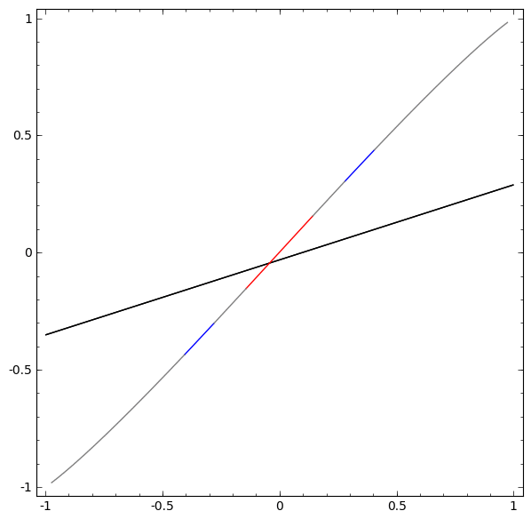
Deep neural networks
Source: Chris Olah’s blog (http://colah.github.io/posts/2014-03-NN-Manifolds-Topology/)

Slide 42
DNNs as universal approximators
Goal: We want to approximate the decision boundary function with neural networks
Approximable function: f is approximable by neural networks if , there exist a neural network N such that:

Slide 43
DNNs as universal approximators
Goal: We want to approximate the decision boundary function with neural networks
Approximable function: f is approximable by neural networks if , there exist a neural network N such that:
Cybenko (1989): For any continuous function f, there exists a neural network N with sigmoid activation functions that can approximate f with error (this result was for shallow networks).

Slide 44
DNNs as universal approximators
Goal: We want to approximate the decision boundary function with neural networks
Approximable function: f is approximable by neural networks if , there exist a neural network N such that:
Cybenko (1989): For any continuous function f, there exists a neural network N with sigmoid activation functions that can approximate f with error (this result was for shallow networks).
Deep networks: Rolnick&Tegmark (2018) + Kidger&Lyons (2020): deep neural nets with ReLU can use exponentially smaller number of neurons to achieve same unversal approximability

Slide 45
DNNs as universal approximators
Goal: We want to approximate the decision boundary function with neural networks
Approximable function: f is approximable by neural networks if , there exist a neural network N such that:
Cybenko (1989): For any continuous function f, there exists a neural network N with sigmoid activation functions that can approximate f with error (this result was for shallow networks).
Deep networks: Rolnick&Tegmark (2018) + Kidger&Lyons (2020): deep neural nets with ReLU can use exponentially smaller number of neurons to achieve same universal approximability.
Width of the network: Johnson (2019): width <= dimension of inputs -> not universal approximators (doesn’t matter how deep the network is). Hanin&Sellke (2018): width = #(input_dim) + 1 suffices.

Slide 46
Convolutional neural nets
Images taken from book of Aurélien Géron: Hands-On Machine Learning with Scikit-Learn & TensorFlow

Slide 47
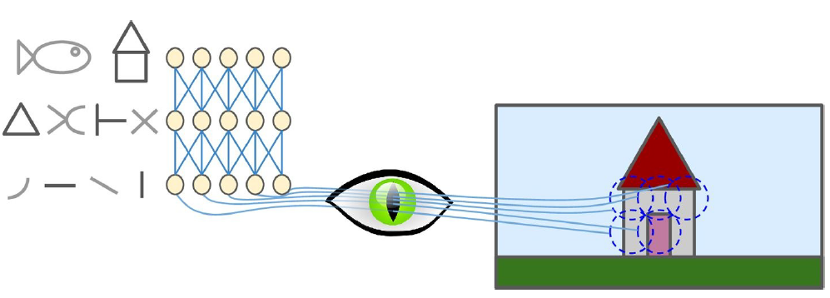
Neural nets in computer vision:
One of the core domains of CS and AI
Identify (classify) visual objects
NNs are the state-of-the-art solution techniques
Natural representation of human vision
Intuitive model for convolutional networks (CNNs)

Slide 48
Ideally (before discussing CNNs):
DNN with fully connected layers (each node is connected to every single node in the next layer):
Can learn (almost) any data model
E.g., if we don’t need a connection -> set its weight close to 0
So it should be able to classify the visual object
Issues:
Too many parameters
E.g., 100x100 picture (in pixels) – 1st hidden layer with 1000 neurons -> 10 million connections

Slide 49
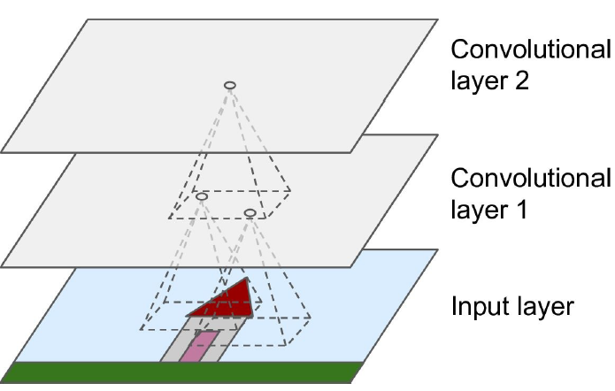
Main idea
Convolutional layer:
Neurons in the first convolutional layer are not connected to every single pixel in the input image, but only to pixels in their receptive fields

Slide 50
Convolutional neural nets
Convolutional layer:
Motivated by nature
neurons in the first convolutional layer are not connected to every single pixel in the input image, but only to pixels in their receptive fields
Next convolutional layer: each neuron is connected only to neurons within a small rectangle of first layer
Etc.
Main benefits:
Can learn a lower level non-linear representation of data
Differentiable -> can use SGD to train

Slide 51
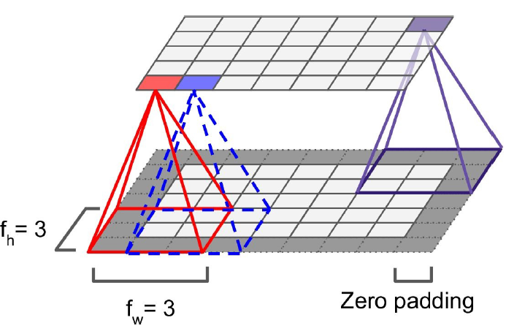
Zero padding

Slide 52
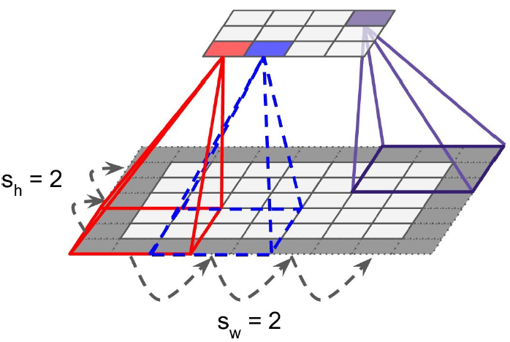
Reducing size of convolutional layer:
Stride: size of jump between neighbouring rectangles
Using large strides will significantly reduce the layer’s size, but the cost is information loss

Slide 53
Filters
Weight of edges that connect the rectangle with the neuron together form a matrix
Matrix = filter
E.g.:
= only consider the central line
and ignore the rest

Slide 54
Pooling layers
Goal: to reduce input image size (to reduce computational load, memory, etc)
Additional consequence: location invariance – the CNN can tolerate a small image shift
Pooling layer: similar to convolutional layer – each neuron is connected to a rectangle of input layer
Rectangle size, stride, padding, etc are the same
But there are NO WEIGHTS!!!
Aggregation: max or mean
Max pooling: aggregation = max (other inputs are dropped)
Average pooling: aggregation = mean

Slide 55
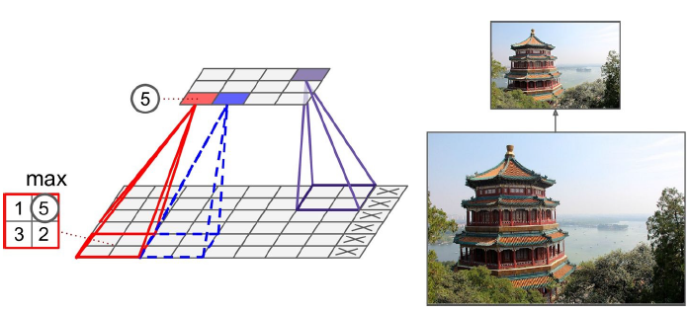
Max pooling example

Slide 56
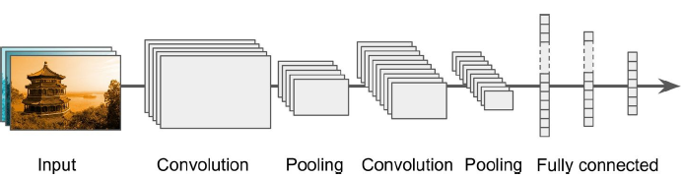
CNN architectures

Slide 57
Universal approximability of CNNs
Yarotsky (2018) + Zhou (2018): CNNs with arbitrary depth are universal approximators
Open problems: Minimum depth? Minimum width?

Slide 58
Deep reinforcement learning

Slide 59
Deep reinforcement learning
Use DNNs to represent
Value, Q function
Policy
Model
Optimise loss function by stochastic gradient descent (SGD)
Notable example: DQN (deep Q-network)

Slide 60
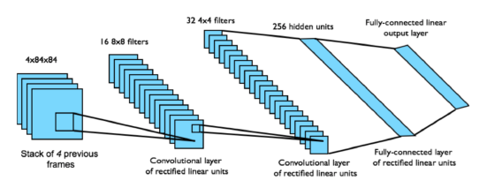
Architecture of DQNs
DQNs for Atari games:
End-to-end learning of values Q(s, a) from pixels s
Input: state s is stack of raw pixels from last 4 frames
Output: Q(s, a) for 18 joystick/button positions
Reward: change in score for that step
Network architecture and hyperparameters fixed across all games
Taken from Emma Brunskill’s slides

Slide 61
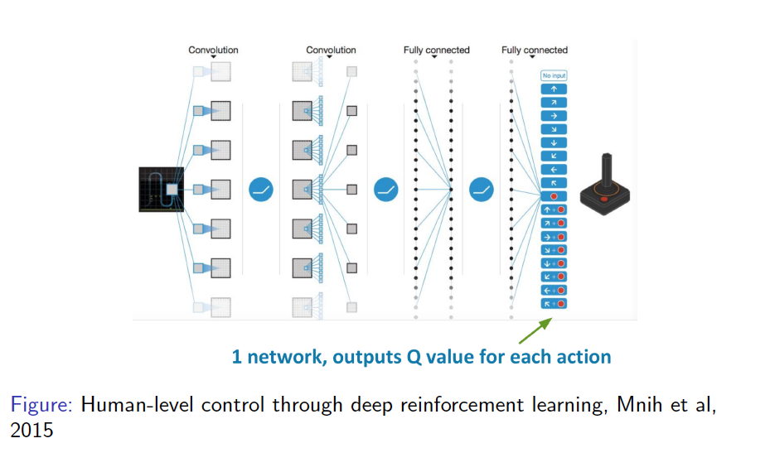
Architecture of DQNs
Taken from Emma Brunskill’s slides

Slide 62
Advantages of DQNs
Q-learning:
Converges to the optimal Q(s, a) using table lookup representation
But Q-learning with value function approximation can diverge

Slide 63
Advantages of DQNs
Q-learning:
Converges to the optimal Q(s, a) using table lookup representation
But Q-learning with value function approximation can diverge
Two of the issues causing problems:
Correlations between samples
Non-stationary targets

Slide 64
Advantages of DQNs
Q-learning:
Converges to the optimal Q(s, a) using table lookup representation
But Q-learning with value function approximation can diverge
Two of the issues causing problems:
Correlations between samples
Non-stationary targets
Deep Q-learning (DQN) addresses both of these challenges by
Experience replay
Fixed Q-targets

Slide 65
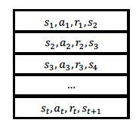
Experience replay
Issue: correlation between consecutive samples (i.e., current state-action pair affects the success of next state-action)
Solution:
Store previous experience tuples in a table (replay buffer) D
Sample a tuple // similar to bootstrapping

Slide 66
Experience replay
Issue: correlation between consecutive samples (i.e., current state-action pair affects the success of next state-action)
Solution:
Store previous experience tuples in a table (replay buffer) D
Sample a tuple // similar to bootstrapping
Compute the target value for the sampled s:
Use SGD to update the network weights w:

Slide 67
Experience replay
Issue: correlation between consecutive samples (i.e., current state-action pair affects the success of next state-action)
Solution:
Store previous experience tuples in a table (replay buffer) D
Sample a tuple // similar to bootstrapping
Compute the target value for the sampled s:
Use SGD to update the network weights w:
New issue: w gets updated on the next round, changing the target value -> not converge to the Q function

Slide 68
Fixed Q-target
Issue: In experience replay, w gets updated on the next round, changing the target value -> not converge to the Q function
Solution:
Fix the weight w in target calculation for multiple updates -> improve stability
: fixed weight used to calculate multiple target values

Slide 69
Fixed Q-target
Issue: In experience replay, w gets updated on the next round, changing the target value -> not converge to the Q function
Solution:
Fix the weight w in target calculation for multiple updates -> improve stability
: fixed weight used to calculate multiple target values
Compute the target value for the sampled s (now with fixed target weights):
Use SGD to update the network weights w (with a fixed target):

Slide 70
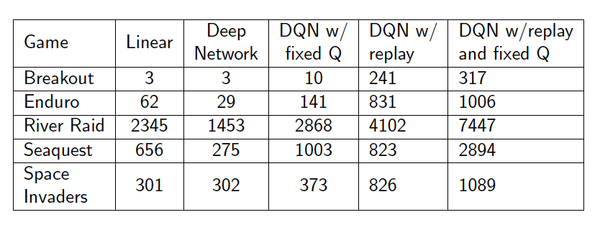
DQN vs. other function approximation methods
Taken from Emma Brunskill’s slides

Slide 71
More advanced deep RL (not covered in this course)
Double DQN (Deep Reinforcement Learning with Double Q-Learning, Van Hasselt et al, AAAI 2016)
Prioritized Replay (Prioritized Experience Replay, Schaul et al, ICLR 2016)
Dueling DQN (best paper ICML 2016) (Dueling Network Architectures for Deep Reinforcement Learning, Wang et al, ICML 2016)

